Slide 1
THE SOUND OF SUNSHINE
ATTIVITÁ PROGETTO ERASMUS
A.S. 2021/2022
I.C. PABLO NERUDA
CLASSE 3 B - VIA AUDIFACE ED ABACUC

Slide 2
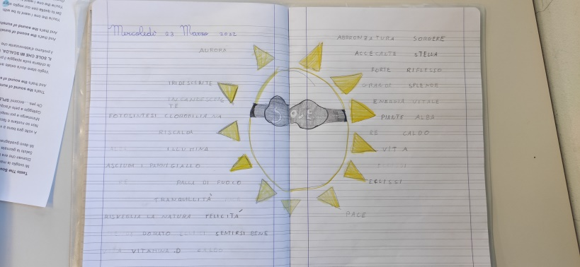
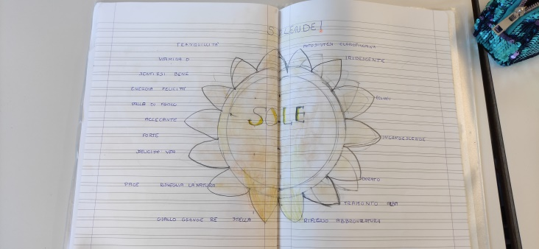
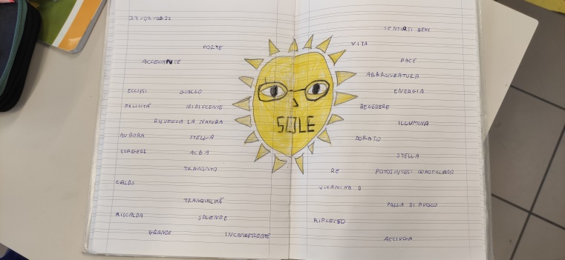
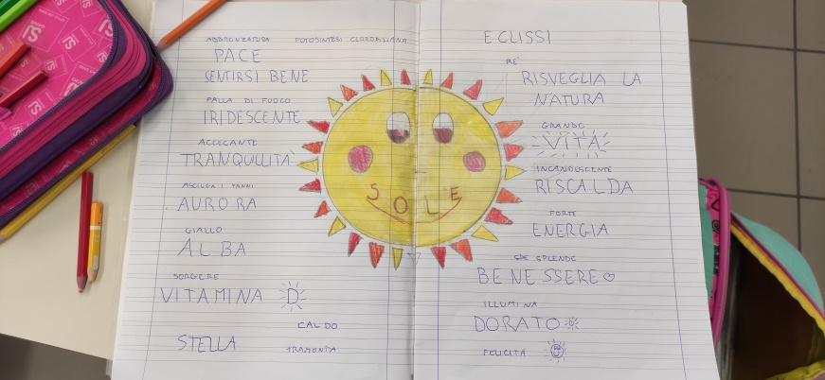
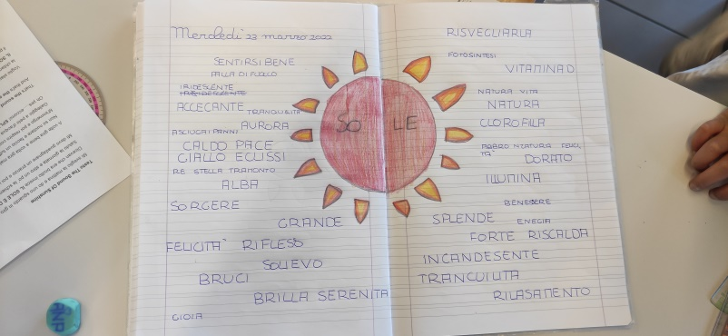
BRAINSTORMING ABOUT THE SUN… What do you think if I tell you “SUN”?

Slide 3
We listened to the song THE SOUND OF SUNSHINE by Lorenzo Jovanotti
https://www.youtube.com/watch?v=HyNHz6SYx-0&list=RDMMHyNHz6SYx-0&start_radio=1

Slide 4
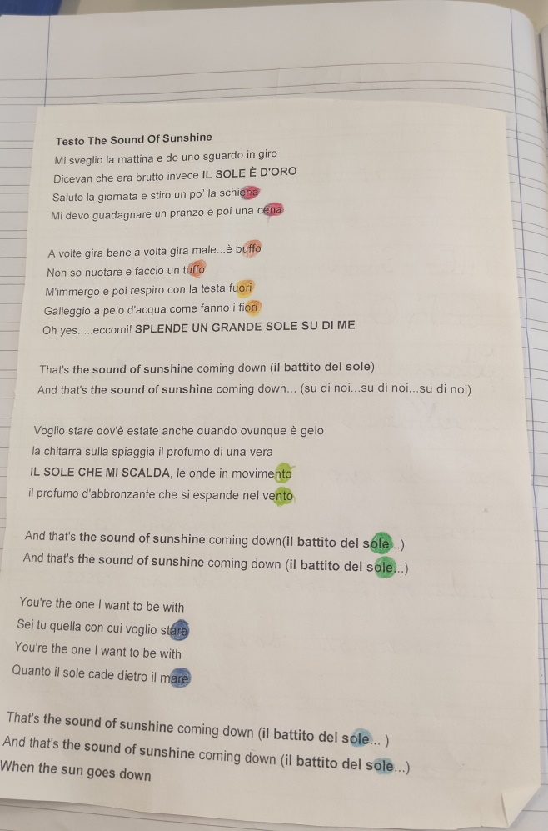
We have read the text, coloured the rhymes and understood the meaning of the song.

Slide 5
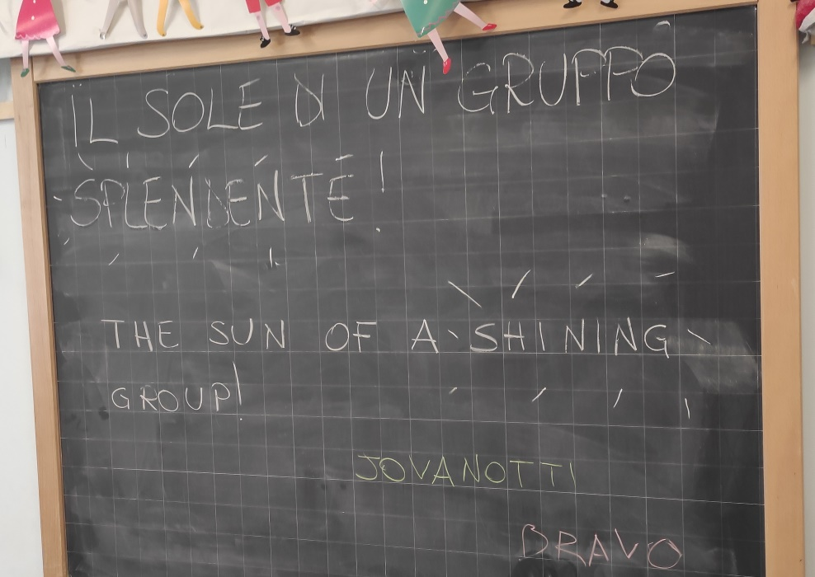
We saw a tutorial for making an ORIGAMI SUN
Each of us made a RAY
and we stuck them ALL TOGETHER.
We found a title for this job:
WE ARE THE SUN OF A SHINING GROUP!

Slide 6
